Slide 1
常年期第二十一主日
2022年 8 月 21 日
感 恩 祭 宴
主 題
窄 門
(依66:18-21 ;希12:5-7,11-13; 路13:22-30)
感恩=基督徒基本心態; 祭=崇拜; 宴=共融

Slide 2
恭讀依撒意亞先知書 66:18-21
上主這樣說：「我要來聚集萬民，及各種語言的民族；他們都要前來，觀看我的榮耀。我要在他們中，施行奇事，並派遣生還的人，到外邦人那裡，即往塔爾史士、普特、路得、默舍客、洛士、突巴耳、雅汪，及遼遠的海島上，即沒有聽過我的聲譽，沒有見過我光榮的地方。
1/2

Slide 3
「他們要從各民族中，用馬、車、轎、騾、獨峰駝，把你們的弟兄，送到我的聖山：耶路撒冷，當作獻於天主的獻儀，好像以色列子民，用潔淨的器皿，將供物獻於上主的聖殿一樣：這是上主說的。我要從他們中間，選拔司祭和肋未人：這是上主說的。」——上主的話。
眾:感謝天主
2/2

Slide 4
恭讀致希伯來人書 12:5-7,11-13
你們竟然忘記了天主勸你們，好像勸子女所說的話：「我兒，不要輕視上主的懲戒，也不要厭惡他的譴責，因為上主懲戒他所愛的，鞭策他所接納的每個兒子。」
為接受懲戒，你們應該堅忍，因為天主對待你們，有如對待子女。那有兒子，做父親的，不懲戒他呢？
1/2

Slide 5
固然各種懲戒，在當時，似乎不是樂事，而是苦事；可是，以後，為那些這樣受過訓練的人，就會結出正義與和平的果實。
為此，你們應該伸直痿弱的手，及麻木的膝；你們的腳，應履行正直的路，叫瘸子不要偏離正道，反叫他獲得痊瘉。——上主的話。
眾:感謝天主
2/2

Slide 6
恭讀聖路加福音 13:22-30
那時候，耶穌經過各城各鄉，前往耶路撒冷，隨處施教。
有一個人對耶穌說：「主，得救的人果然不多嗎？」
耶穌對群眾說：「你們竭力由窄門進入吧！我告訴你們：因為將來有許多人，想要進去，卻不能進去。及至家主起來，把門關上，你們在外面站著，開始敲門，說：主，請給我們開門吧！
1/3

Slide 7
他要回答你們說：我不認識你們是那裡的。那時，你們會說：我們曾在你面前，吃過喝過；你也曾在我們的街市，施教過。
「他要說：我告訴你們：我不認識你們是那裡的；你們這些作惡的人，都離開我吧！
「幾時你們望見亞巴郎、依撒格、雅各伯，及眾先知，在天主的國裡，你們卻被摒棄在外面，你們只有哀號和切齒。
2/3

Slide 8
將有從東從西，從北從南而來的人，參加天主國裡的筵席。
「看！有最後的，將成為最先的，也有最先的，將成為最後的。」
——基督的福音。
眾：基督，我們讚美你！
3/3

Slide 9
常年期第二十一主日
2022年 8 月 21 日
感 恩 祭 宴
主 題
窄 門
(依66:18-21 ;希12:5-7,11-13; 路13:22-30)
感恩=基督徒基本心態; 祭=崇拜; 宴=共融

Slide 10
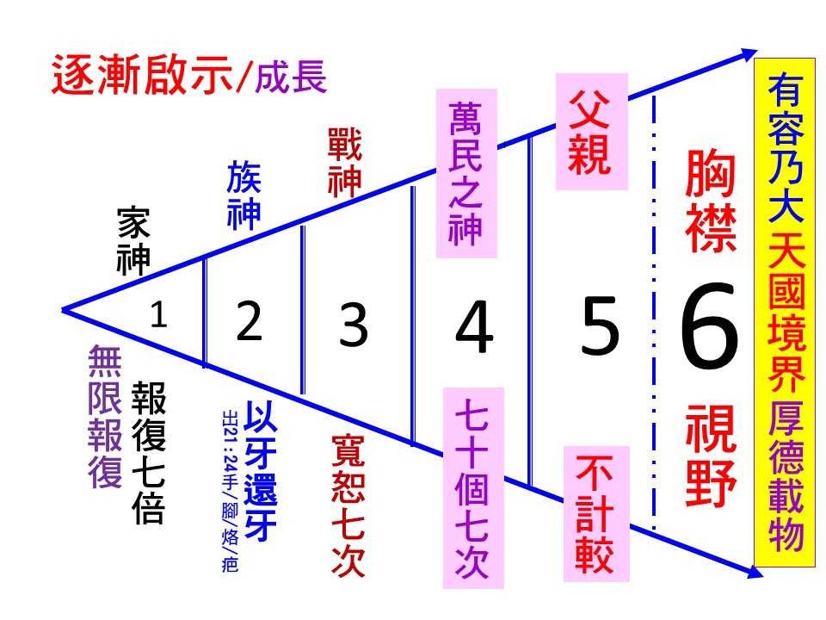
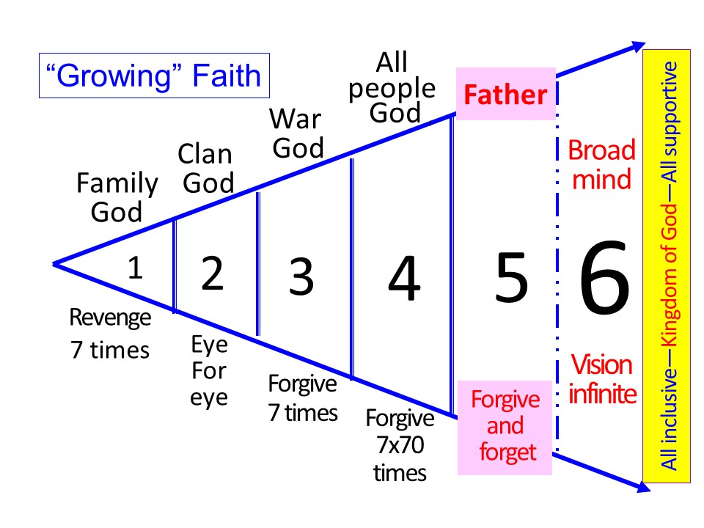
我要來聚集萬民;他們都要前來,
觀看我的榮耀.
天國屬於天主,與萬民分享 (for the people)
天國包容一切(有容乃大,厚德載物;太陽雨露)
天國超越黨派/政制(黃/藍/綠;民主政制與否)
天國超越宗教(有/無神;古往今來無所不在)
天主的榮耀Gloria Dei homo vivens
(沒有優先:中國/美國/信不信神/好人壞人)

Slide 11
我兒,不要輕視上主的懲戒,因為上主鞭策他所接納的每個兒子;固然各種懲戒,在當時,是苦事;可是,以後,為那些這樣受過訓練的人,就會結出正義與和平的果實.
信神的國家多蒙天主的祝福？
(有些傳道人在國內傳教胡說八道)
天主不直接干預人間禍福
→人神合作;盡人力而聽天命DYBGDR

Slide 12
主,得救的人果然不多嗎?——你們竭力由窄門進入吧!我告訴你們:因為將來有許多人,想要進去,卻不能進去.
你們要從窄門進去，因為寬門和大路導入喪亡；但有許多的人從那裡進去。那導入生命的門是多麼窄，路是多麼狹！找到它的人的確不多。」(瑪7:13-14)
新潮傳教?用潮語?取悅青年人?「生得積極,死得安樂」很容易?「家和萬事興」唾手可得?不用腦筋可以萬事大吉?

Slide 13
《孔子家語》有一則小故事:子貢問孔子有關死人有沒有知覺的問題.
There is an anecdote in the Confucius Book of Sayings: Zi Gong asked Confucius whether
the dead possessed consciousness.

Slide 14
孔子回答說:「如果我說死人『有知覺』,
我就害怕有些人會『妨生而送死』(只理死人,不顧生者); 如果我說死人『無知覺』,
我又擔心有些人不去埋葬去世的父母,
使他們暴骨荒野。
Confucius replied: If I say the dead possess consciousness, some may care about the dead and not about the living.
If I say the dead do not possess consciousness, others may not bury their dead parents but
leave their bodies to rot in the wilderness.

Slide 15
所以我無論怎麼回答,對你們都沒有什麼好處.其實,欲知死者有知或無知,
「非今之急,後自知之」.
孔子不回答無聊的,無用的問題.
So whatever answer I give will not benefit anyone in any way. In fact, knowledge of whether the dead have consciousness is not of immediate urgency, but something you will learn for yourself. Confucius did not answer meaningless questions!

Slide 16
耶穌也不回答無聊,無用的問題.有人問耶穌:「主,得救的人果然不多嗎?」
耶穌答:「你們竭力由窄門進入吧!」
似乎是答非所問.
Nor did Jesus answer meaningless and useless questions. Someone had asked Jesus: “Lord, are there very few people who are saved?” To this Jesus replied: “Try your best to enter the narrow gate!” An answer that did not seem to address the question.

Slide 17
耶穌不回答得救人數的多寡,理由是,如說得救的人多,你會等閒視之,反正人人都可能得救;如說得救的人少,你會失望,「幾時輪到我?」這也是一個無用的問題,答案一定是有害無益.
The reason why Jesus did not answer the question about the number of people who would be saved was: if the reply was a large number, salvation would not be taken seriously, as most would consider themselves saved; but if the number was small, then most would be disappointed that they would be excluded from redemption. Such is also a useless question that would bring upon a harmful answer.

Slide 18
耶穌不回答得救人數的多寡,理由是,如說得救的人多,你會等閒視之,反正人人都可能得救;如說得救的人少,你會失望,「幾時輪到我?」這也是一個無用的問題,答案一定是有害無益.
The reason why Jesus did not answer the question about the number of people who would be saved was: if the reply was a large number, salvation would not be taken seriously, as most would consider themselves saved; but if the number was small, then most would be disappointed that they would be excluded from redemption. Such is also a useless question that would bring upon a harmful answer.
不問蒼生問鬼神
咁大件事,「問米」都
不問專業人士?

Slide 19
耶穌的這個回答卻值得警惕:因為將來有許多人,想要進去,卻不能進去.及至家主起來,把門關上,你們在外面站著,開始敲門,說:主,請給我們開門吧!主的回答是:我不認識你們是哪裡的.
Jesus’s reply should serve as a warning to us, that many will want to enter into Heaven, but will be denied entry. When the master comes and shuts them out of the door, they will knock and say: “Lord, open the door for us’’, and the Lord will reply: “I don’t know who you are.”

Slide 20
那時,你們會說:我們曾在你面前,吃過喝過;你也曾在我們的街市,施教過(我們是自家人啊!)但主卻說:我不認識你們是哪裡的;你們這些作惡的人,都離開我吧!
At that time, you will say: We had been with you, eating and drinking with you; you had been with us and had taught us in the market (we are of the same family!). But the Lord will say:
“I never knew you.
Depart from me, you evildoers!
自視為基督徒卻把基督放在最後,有用嗎?

Slide 21
瑪竇也有類似的記載:不是凡向我說『主啊!主啊!』的人,就能進入天國;而是那承行我在天之父旨意的人,才能進天國.
(瑪7:21-23)
"Not everyone who says to me,
'Lord, Lord,' will enter the
kingdom of heaven, but only the one who does the will of
my Father in Heaven.(Mt7:21-23)

Slide 22
到那一天有許多人要向我說:『主啊!主啊!我們不是因你的名字說過預言,因你的名字驅過魔鬼,因你的名字行過許多奇跡嗎?』(我們是超級基督徒啊!)那時我必要向他們聲明說:我從來不認識你們;你們這些作惡的人,離開我吧!
Many will say to me on that day, 'Lord, Lord, did we not prophesy in your name? Did we not drive out demons in your name? Did we not do mighty deeds in your name?' (We are super Christians!) Then I will declare to them solemnly, 'I never knew you.
Depart from me, you evildoers.'

Slide 23
到那一天有許多人要向我說:『主啊!主啊!我們不是因你的名字說過預言,因你的名字驅過魔鬼,因你的名字行過許多奇跡嗎?』(我們是超級基督徒啊!)那時我必要向他們聲明說:我從來不認識你們;你們這些作惡的人,離開我吧!
Many will say to me on that day, 'Lord, Lord, did we not prophesy in your name? Did we not drive out demons in your name? Did we not do mighty deeds in your name?' (We are super Christians!) Then I will declare to them solemnly, 'I never knew you.
Depart from me, you evildoers.'
名稱不一定代表實質
最難名實相符
信神的人未必相信天主無所不在
7歲偷食;17歲考試偷睇;27歲偷名; 37歲偷人(騙婚);47歲偷天換日

Slide 24
你們要從窄門進去,因為寬門和大路導入喪亡;但有許多人從那裡進去.
那導入生命的門是多麼窄,路是多麼狹!
找到它的人的確不多.(瑪7:13-14)
"Enter through the narrow gate; for the gate that is wide and the road broad leads to destruction, and those who enter through it are many. But small is the gate and narrow the road that leads to life, and only a few find it.’’ (Mt 7:13-14)

Slide 25
看看耶穌在路加福音6:20-26中,怎樣為窄門寬門下定義:你們貧窮的是有福的,因為天主的國是你們的;但是你們富有的是有禍的,因為你們已經獲得了你們的安慰
See how Jesus defined narrow gates in the Gospel of Luke 6:20-26. Blessed are you who are poor, for the kingdom of God is yours. But woe to you who are rich, for you have received your consolation. (Furthermore, wealth if misused will become toxic and lead to eternal punishment.)
財富如被濫用,必成毒藥,導致永罰

Slide 26
你們現今飢餓的是有福的,因為你們將得飽飫;你們現今飽飫的是禍的,
因為你們將要飢餓
Blessed are you who are now hungry, for you will be satisfied. But woe to you who are filled now,
for you will be hungry.
愛人者,人恆愛之;我餓了,你給了我吃的
People who love others will be loved. When I was hungry, you gave me food.
(Mt 25:35)

Slide 27
你們現今哭泣的是有福的,因為你們將要歡笑;你們現今歡笑的是有禍的,
因為你們將要哀慟哭泣.
Blessed are you who are now weeping, for you will laugh (sweetness comes when bitterness has its fullest share); Woe to you who laugh now, for you will grieve and weep. (Tragedy follows on the heels of merriment). A single mistake can cause perpetual sorrow. But he who brings joy to others will be rewarded a hundredfold).
苦盡甘來,樂極生悲;一失足成千古恨;幫助別人快樂的,必有百倍賞報(谷10:28-31)

Slide 28
願 好 天 主
祝 福 你 的 家 庭
你 的 工 作
幫助你戰勝疫情
化 危 為 機
天主愛你 主佑！

